Slide 1
Responding to an Electronic Bid
5 Step Instructions

Slide 2
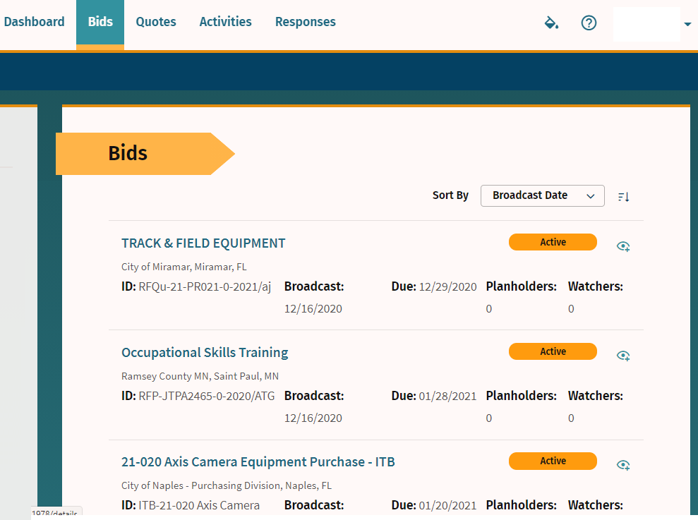
Step 1
Many governments are moving toward requiring bid responses electronically. Here are the steps to respond to an eBid.
Click on the solicitation.

Slide 3
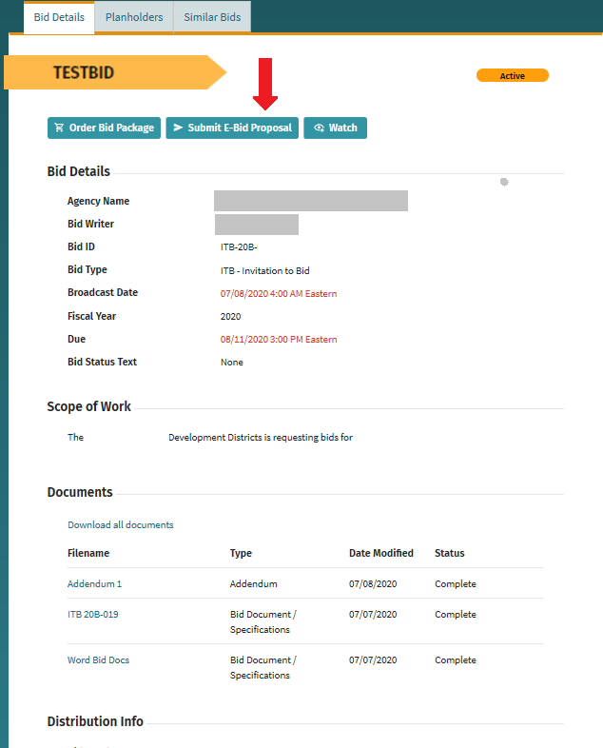
Step 2
Once you are in the solicitation, you will see the Bid Details page that is standard for all solicitations.
When you are ready to submit your bid, click on “Submit E-Bid Proposal”.
There is no charge for you to submit your proposal through this electronic process.

Slide 4
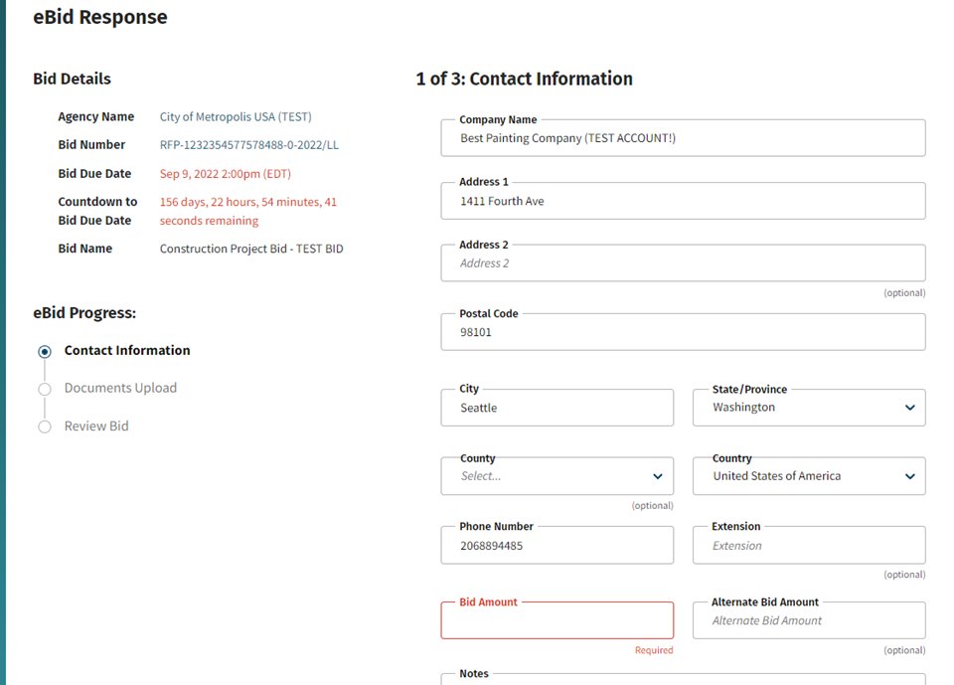
Step 3
Enter information requested page-by-page and you can see what will come next via the menu bar on the left under “E-Bid Progress”.
If required, put in the total bid amount on this page as it will automatically be included in the Tabulation Form to be shown during the public opening on the due date/time.

Slide 5
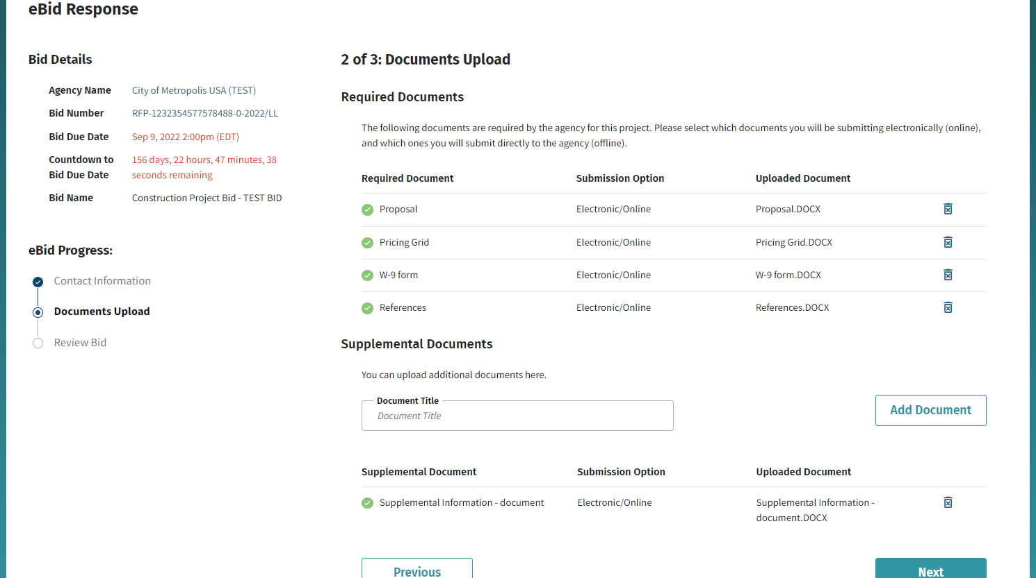
Step 4
After you click NEXT on the Contact Information page, you will be directed to enter the documents required.
NOTE: if you are not submitting a document listed as required, you must still change the “submission option” to reflect the status.
TIP: There is also a place for you to add “Supplemental”, i.e. non-required, documents.

Slide 6
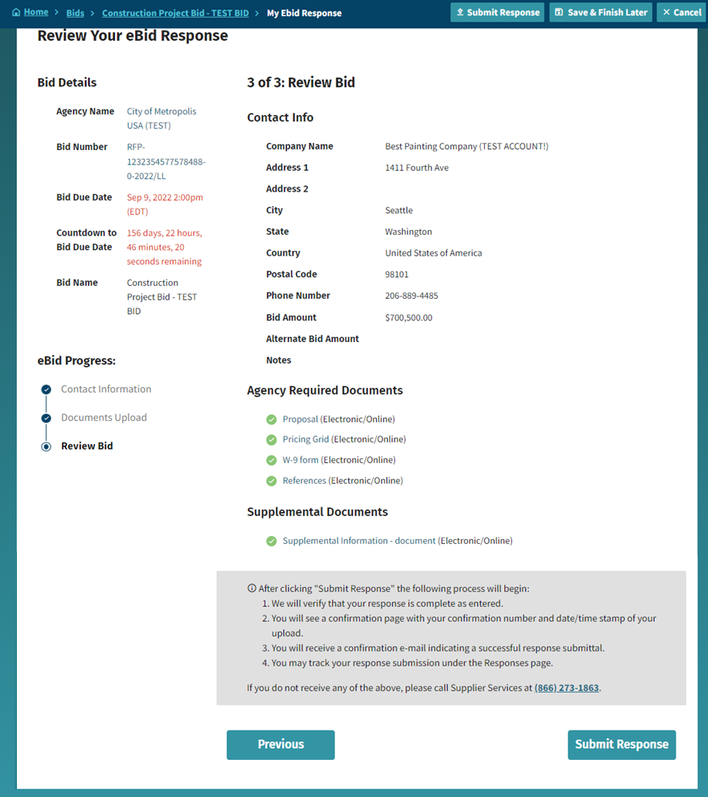
Step 5
Review Your E-Bid Response, and if everything is correct, then press “Submit Response”.
You are done! And the government to which you’ve submitted this will download your responses and documents (after the due date/time) and see the day and time upon which you submitted your proposal.
For more help in responding to an eBid, please call (206) 940-0305 or email: support@demandstar.com

Slide 7
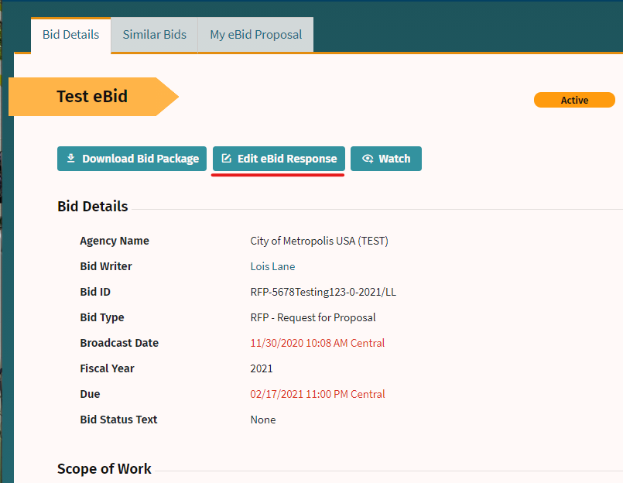
CONFIRMATION
Note that you can update your eBid response until the Bid Due Date and Time.

Slide 8
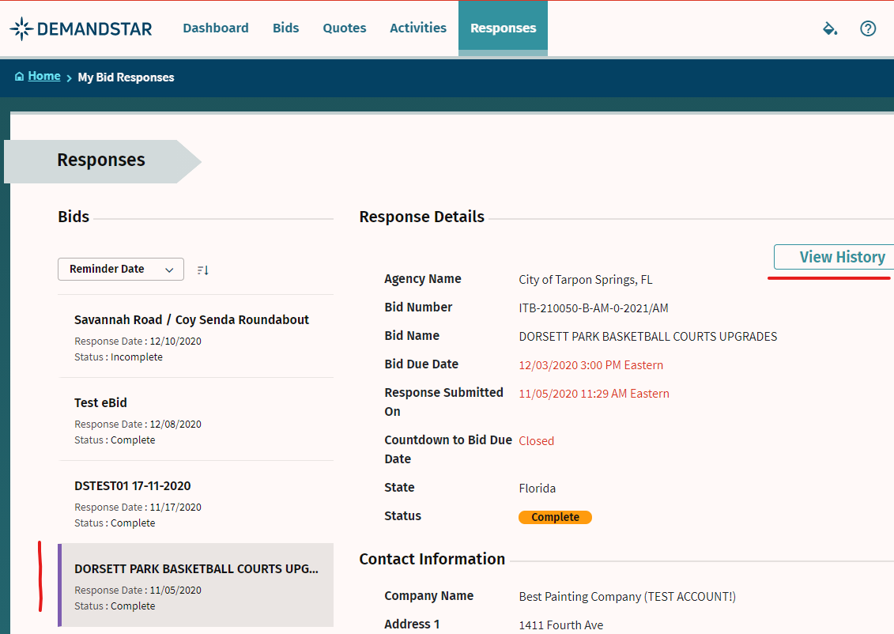
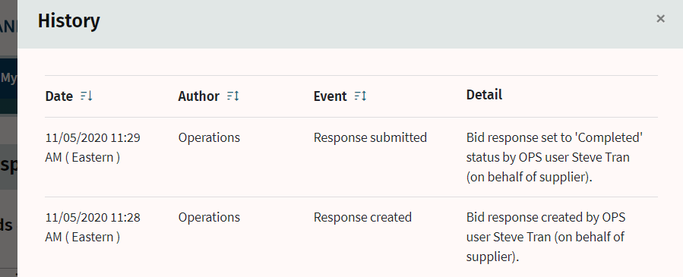
CONFIRMATION
You may change information and re-upload documents until the due date.
[NOTE: make sure you are doing this well before the time of the opening as it may take time to load all the documents required ]
Confirm your eBid responses:
View History per each solicitation to which you responded via the “Responses” menu
For more help in responding to an eBid, please call (206) 940-0305 or email: support@demandstar.com

