Slide 1
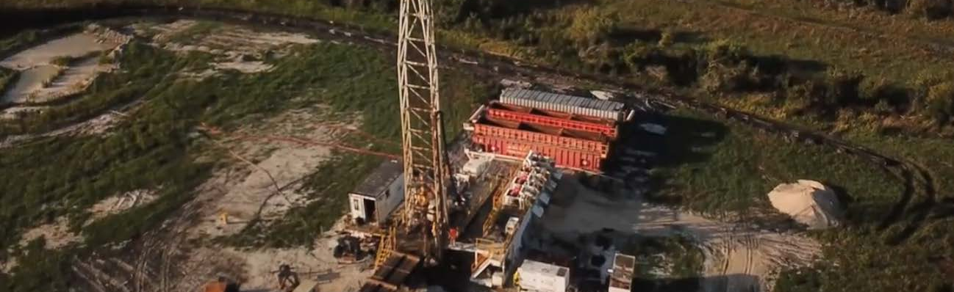



August 13, 2019
Frostproof Site
Hydrogeological Investigation of
the Lower Floridan Aquifer (P280)
Summary of Phase 1 Results – Presentation to the Public Supply & Industrial Advisory Committees

Slide 2
AGENDA
Introduction and Background
Phase 1
  Purpose and Objectives
Phase 1 Drilling and Testing Program
Phase 1 Results
  Lithology
  Groundwater Elevations
  Water Quality
  Hydraulic Parameters
  Monitoring Well Installation
Next Steps
2

Slide 3
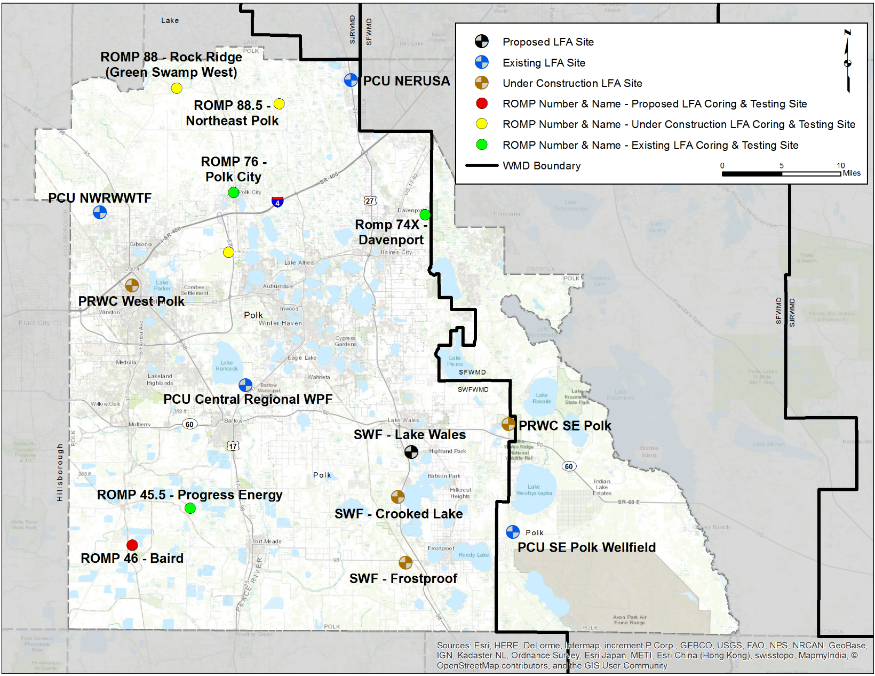
INTRODUCTION
Frostproof Site
      One of three P280 LFA well drilling sites
  Southern most site
  Near Frostproof, FL
3

Slide 4
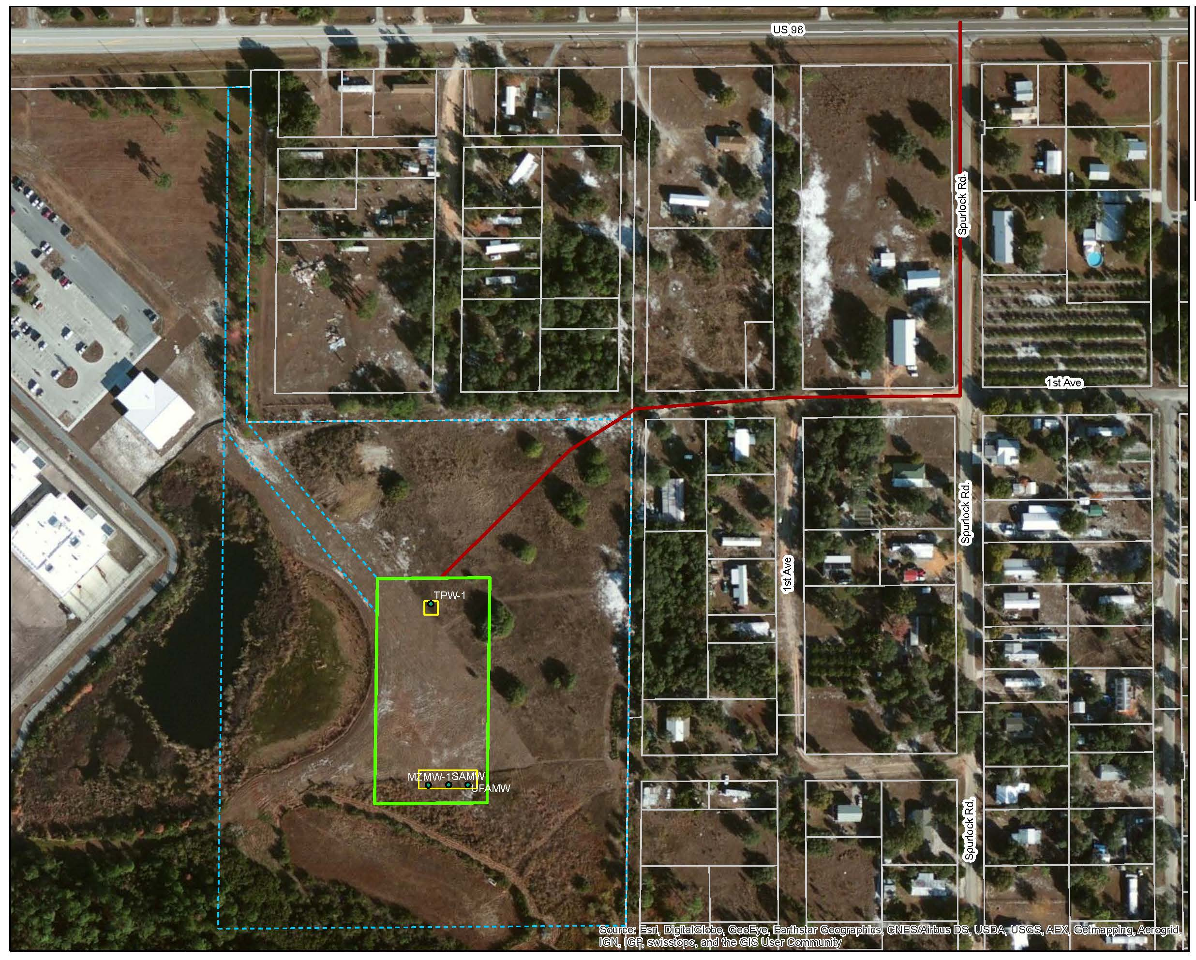
4

Slide 5
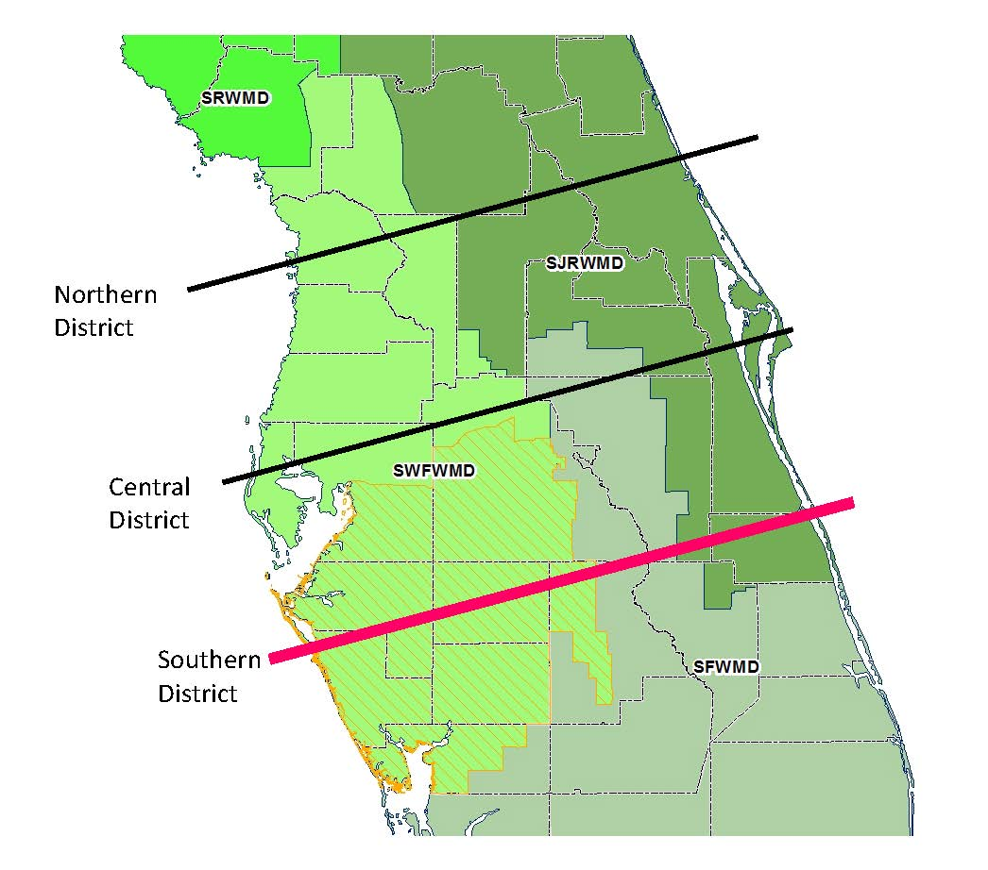
BACKGROUND
HYDROGEOLOGY
Approximate project location
5

Slide 6
Phase 1— Purpose & Objectives
Raw Water Production
                Determine if the LFA can support future brackish water supply
Confinement
  Determine if there is sufficient confinement between UFA/LFA
Concentrate Disposal
  Determine if the LFA could support future injection wells for membrane concentrate disposal
6

Slide 7
Phase 1—Drilling & Testing Program
Monitoring Well Installation
  Surficial aquifer (SAMW-1)
  Upper Floridan aquifer (UFAMW-1)
Drilling
  Drill to sub-Floridan confinement
  Continuous lithologic sampling
  Cores at four discrete depths
Groundwater Elevations
Geophysical and OBI Logging
Hydraulic and Water Quality Data
  Incrementally during drilling
Packer Testing
  7 discrete depths
LFA Monitoring Well Completion
  Dual zone monitoring, LFAI, LFAII(a)
Constant Rate Aquifer Tests
  Water quality sampling
7

Slide 8
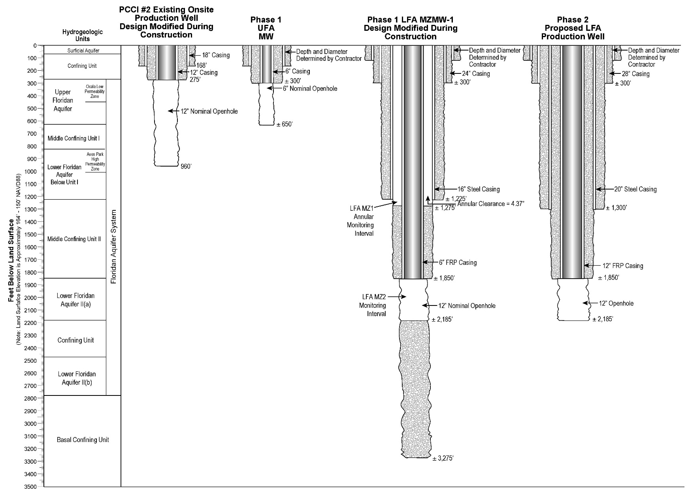
8

Slide 9
Phase 1—Groundwater Elevation (ft NAVD88)
Intermediate casing installation
Note: GWEs not corrected for salinity
10

Slide 10
Phase 1—Groundwater Elevation (ft NAVD88)
Depth of Drilled Pilot Hole (ft bgs)
<0.5 ft
Note: GWEs not corrected for salinity
Intermediate casing installation
11

Slide 11
UFA/LFA Groundwater Elevation Difference
Note: GWEs not corrected for salinity
Phase 1 Results—Vertical Flow Gradients
Graphic plots MZMW-1 GWE – UFAMW-1 GWE
Negative difference = downward vertical gradient
LFAI groundwater elevations similar to UFA groundwater elevations
Downward gradient after intermediate casing set
Interflow in the borehole affected water quality results
Intermediate casing
12

Slide 12
MZMW-1 Drill Stem Water Quality
Phase 1 Results—Water Quality
Downward flow in the borehole affected water quality results
Little variation observed between LFAII(a) and LFAII(b) due to intermixing
LFAII
  Chloride ~70 mg/L
  Sulfate ~ 1,800 mg/L
  TDS ~ 3,000 mg/L
Intermediate
casing
13

Slide 13
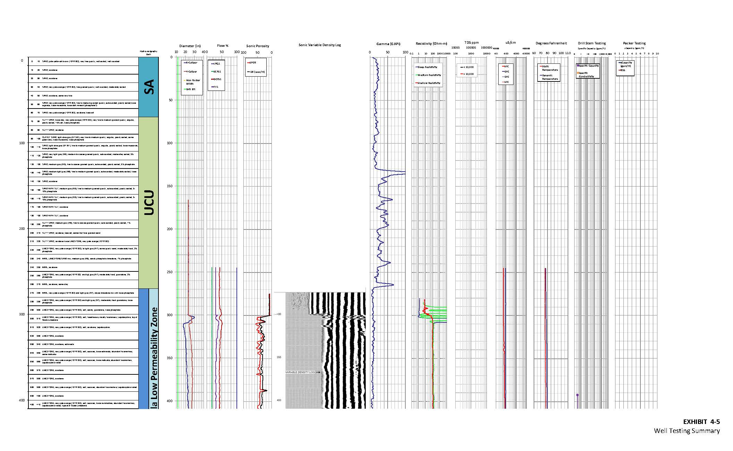
Phase 1 Results—Geophysics with Tentative Hydrogeologic Picks
14

Slide 14
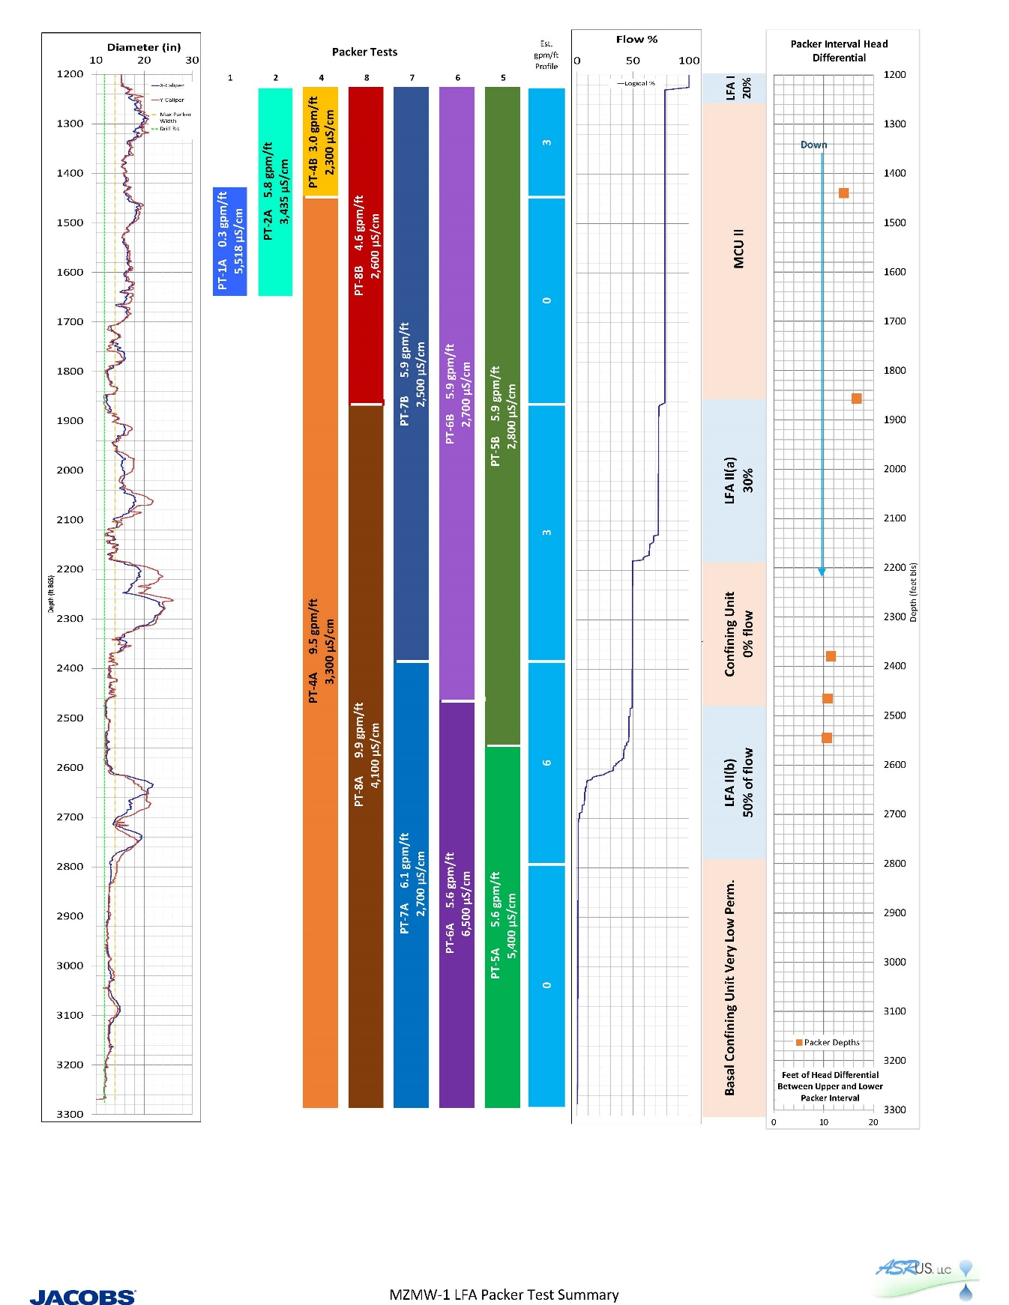
15

Slide 15
Phase 1— Remaining Testing
LFA Monitoring Well Completion
  Dual zone monitoring
Constant Rate Aquifer Tests
  Pumping rate: ~200 – 500 gpm
      LFA I
    LFA II(a)
  Monitoring zones: SA, UFA, LFA I, LFA II(a)
  Water quality: primary, secondary, RO analytes
Lab permeabilities on core
16

Slide 16
Phase 1—Conclusions
Water Supply
Concentrate Disposal
Production zone in LFA II(a)
  3 gpm/ft, estimated
UFA/LFA confinement was identified
  >500 ft thickness
  Packer testing and flow compilation log suggest good confinement
  No effects observed in UFA during testing program
Injection zone in LFA II(b)
  6 gpm/ft, estimated
Confinement between LFA II(a) and LFAII(b)
  ~300 ft thickness
  Geophysical logs suggest two distinct flow zones separated by confining interval
17

Slide 17
Next Steps at Crooked Lake/Frostproof/Lake Wales
Crooked Lake
  Construction on-going with dual zone LFA monitoring well
Frostproof
  Complete Phase 1
  Just kicked-off Phase 2
Lake Wales
  Construction on-going with Phase 1 (similar to Frostproof testing)
18

Slide 18

QUESTIONS & COMMENTS
19

Slide 19
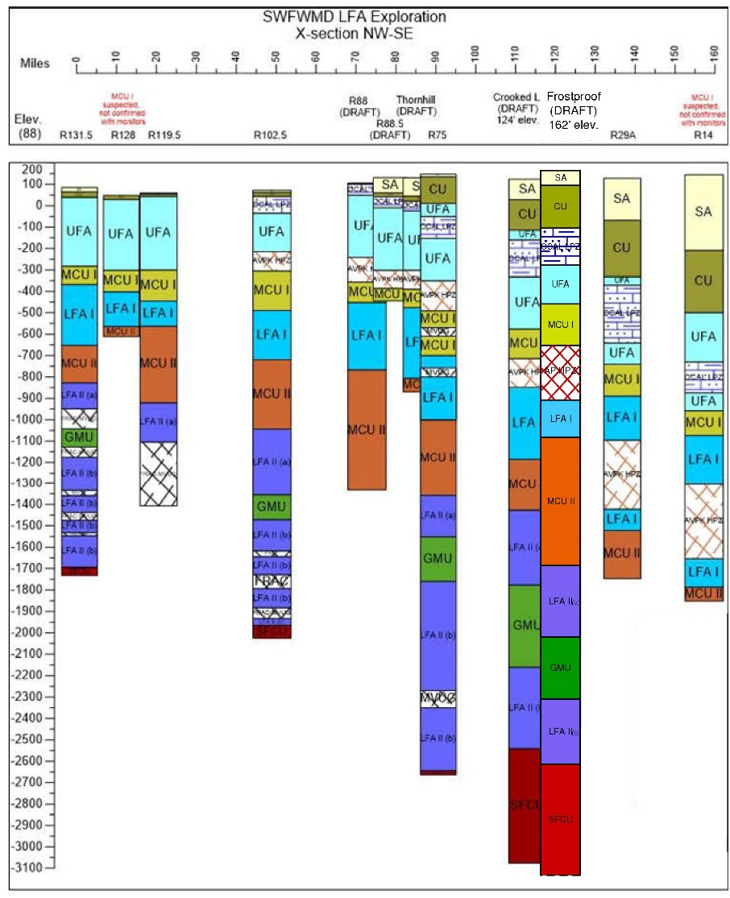
Phase 1 Results—Lithology and Tentative
Hydrogeologic Picks
Stratigraphy |  | Begin Depth (ft bgs) | End Depth (ft bgs) | Thickness (ft)
Ground Surface | GS | 0 | 0 | 0
Surficial Aquifer | SA | 0 | 70 | 70
Confining Unit | CU | 70 | 270 | 200
Upper Floridan Aquifer | UFA | 270 | 625 | 355
Ocala Low Permeability Zone | OCAL LPZ | 270 | 450 | 180
Middle Confining Unit I | MCUI | 625 | 820 | 195
Avon Park High Permeability Zone | AVPK HPZ | 820 | 1075 | 255
Lower Floridan Aquifer I | LFAI | 1075 | 1250 | 175
Middle Confining Unit II | MCUII | 1250 | 1850
Lower Floridan Aquifer IIa | LFAII(a) | 1850 | 2185 | 335
Confining Unit | CU | 2185 | 2475 | 290
Lower Floridan Aquifer IIb | LFAII(b) | 2475 | 2780 | 305
Sub-Floridan Confining Unit | SFCU | 2780 | 3300 | 520
600
9

