Slide 1

Feral Pig Disturbance in Freshwater Wetlands-Damage Rankings
Presented by Cyndi Gates
Sr. Land Management Specialist
Southwest Florida Water Management District
WAP Workshops-April 2014

Slide 2
Impacts of Feral Pigs include:
Alteration of native plant and animal communities
Depredation of crops
Act as a vector for diseases that affect wildlife, livestock, and human health

Slide 3
Damage to Conservation Lands

Slide 4
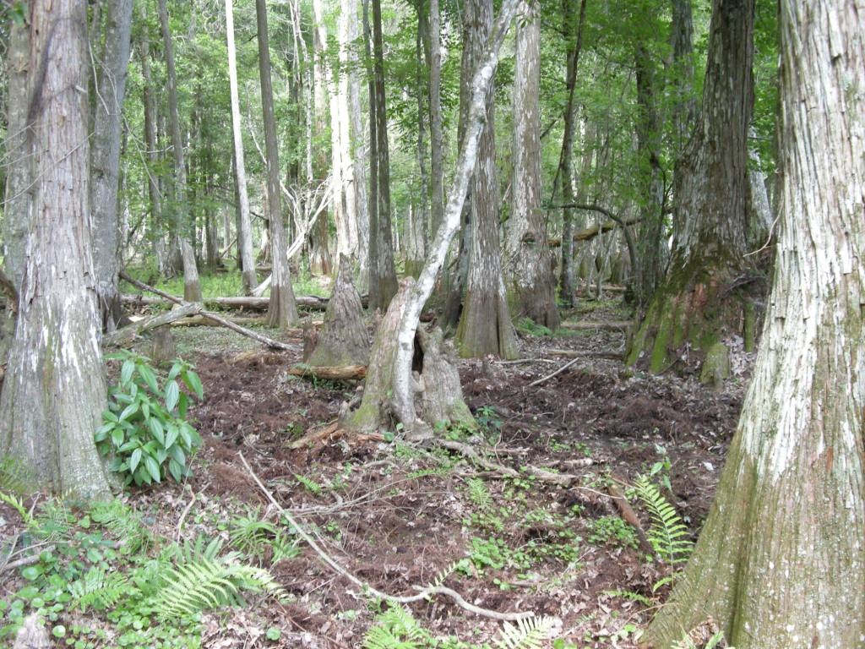
Notes:
Floodplain of the Hillsborough River near the headwaters

Slide 5
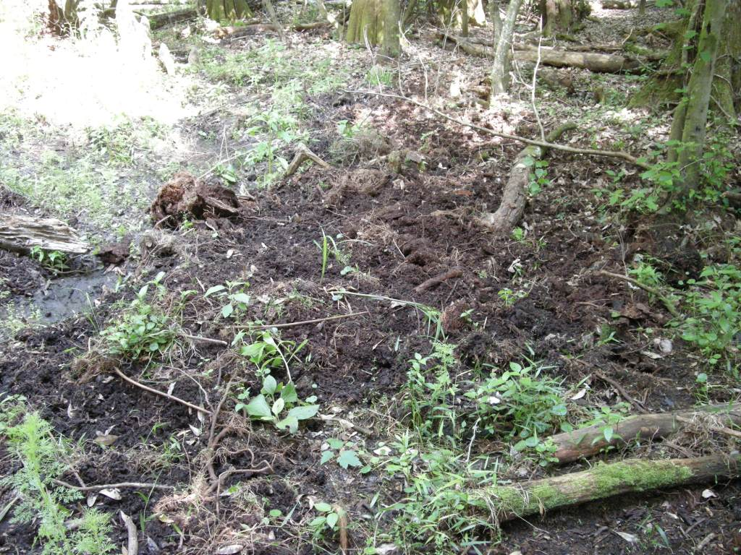
Notes:
Closeup of damage-Upper Hillsborough

Slide 6
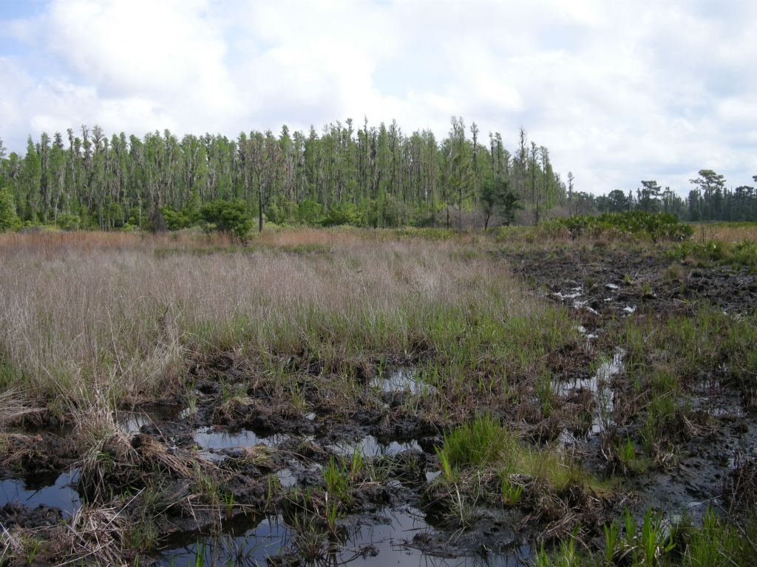
Notes:
District’s Alston Tract in Polk Co.

Slide 7
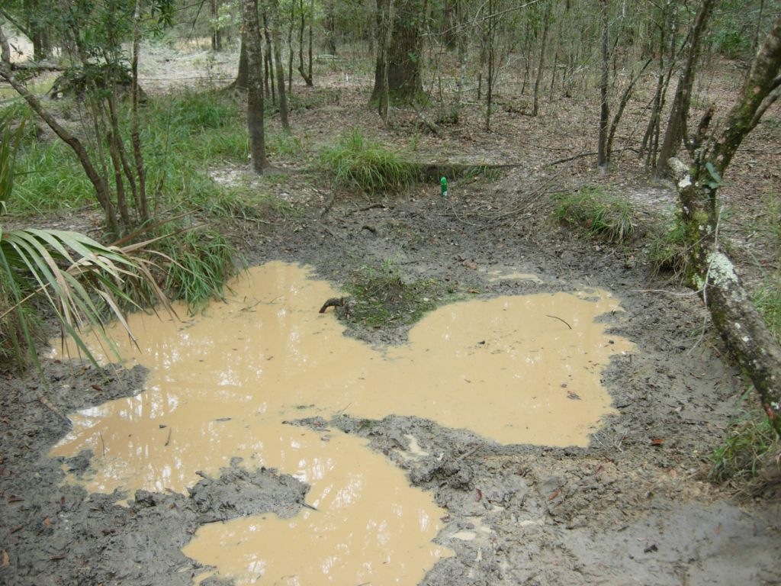
Notes:
Halpata-wallow

Slide 8
How you can help when completing WAP sheet- in comments section please record:
Whether or not wetland is inundated
Zone where damage most prevalent
Estimated size of disturbed area-is rooting impact patchy or continuous?
Estimated depth of rooting
Estimated time since damage

Slide 9
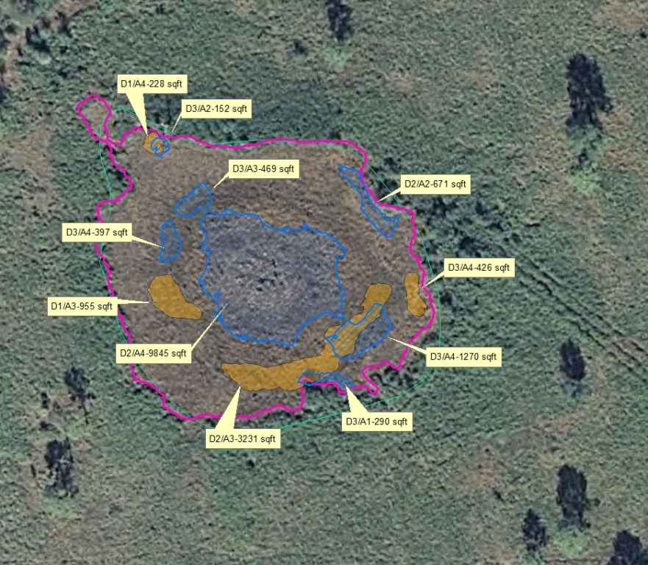
Notes:
District Land Management Specialists associated with our hog control program selected wetlands on various holdings and GPSed and categorized damage using the USDA system. In this photo the polygons in blue were assessed in January 2012 and the polygons in orange were assessed in November 2010. Notice the blue polygons range in time since disturbance from Category 1 (less than 1 week) to Category 4 (4-6 months). If you look at the central blue polygon apparently the wetland was not inundated in the timeframe around September (rooting 4-6 mos. Old).

Slide 10
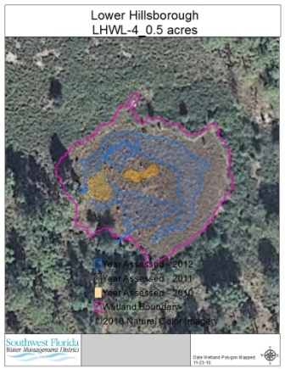
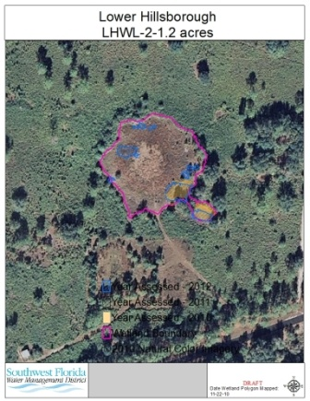
Comparison of Wetlands with Extensive vs. Patchy Damage
Extensive damage-blue
Patchy damage
Notes:
My request of you is that when you are going through your checklist and you notice hog damage please try to note percentage of wetland that is damaged. Any notes you can supply on whether damage is in the deep zone or outer deep zone for instance is much appreciated. If you check that there is no hog damage, please indicate whether wetland is inundated or not.

Slide 11
USDA-Wildlife Services Division Ranking System
Wetland damage rank based on:
Severity-which includes depth and extent of damage
Age of damage or time-since-disturbance
From Report entitled: Development, Implementation, and Evaluation of Management Tools to Reduce Feral Swine Damage at Avon Park AFR, Florida. March 31, 2009. USDA-Wildlife Services
Notes:
Please refer to the pictures in your packet as we describe the ranking system.

Slide 12
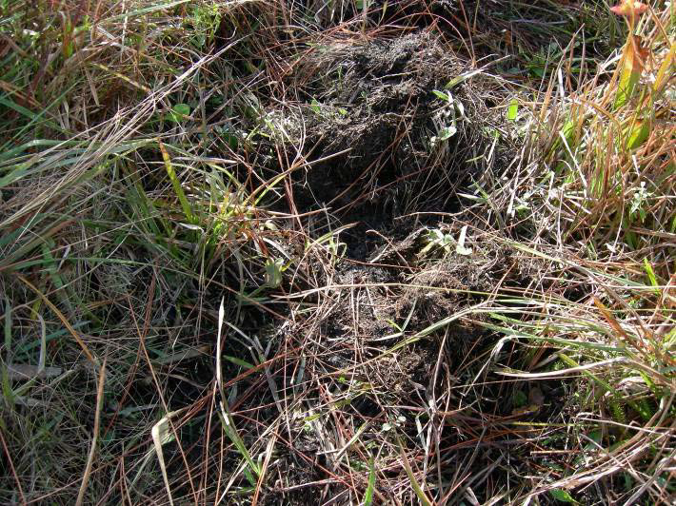
Category 1: Surficial rooting (see Figure 1A for examples)
Foraging at or just below the surface
Rooting depth less than 6 inches
Fewer than 33% of plants uprooted and/or consumed
Less than 33% bare soil
Category 2: Moderate rooting (see Figure 1B for examples)
Foraging below the surface
Rooting depth 4 to 8 inches
33% to 66% of plants uprooted and/or consumed
Up to 66% bare soil

Slide 13
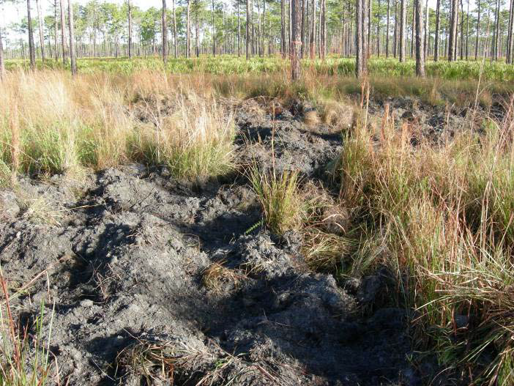
Category 3: Extensive rooting (see Figure 1C for examples)
Foraging below the surface
Rooting depth 4 to 12+ inches
Greater than 66% of plants uprooted and/or consumed
Over 66% bare soil
Category 4: Wallow (see Figure 1D for examples)
Open depression created by “rolling” activity of hogs in sand and/or muck soils
Devoid of vegetation
Often retains water, creating new hydrologic feature

Slide 14
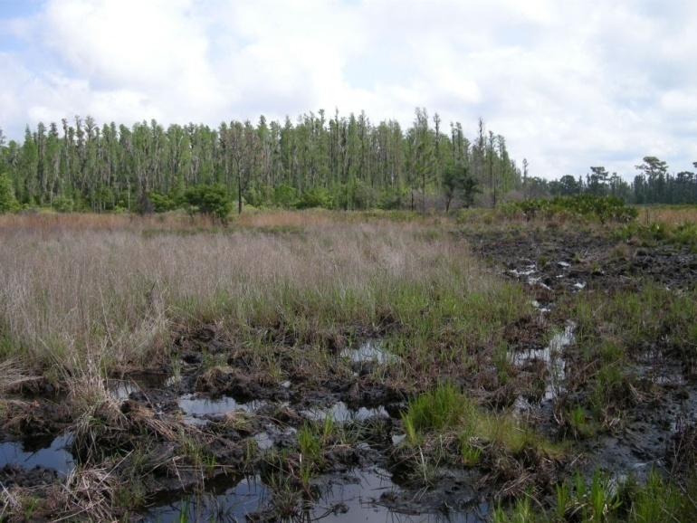
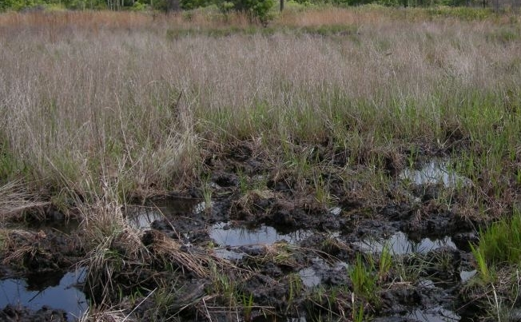
Age Category 1 <1 week
Notes:
Note the vegetation in rooted areas that is still green. You have to be careful with interpretation on age because really wet conditions may preserve plants as opposed to dry times of the year

Slide 15
Notes:
Age category 1 < 1 week. This one is a bit more clear cut because the soils are not inundated and you can see adult plants that are still green.

Slide 16
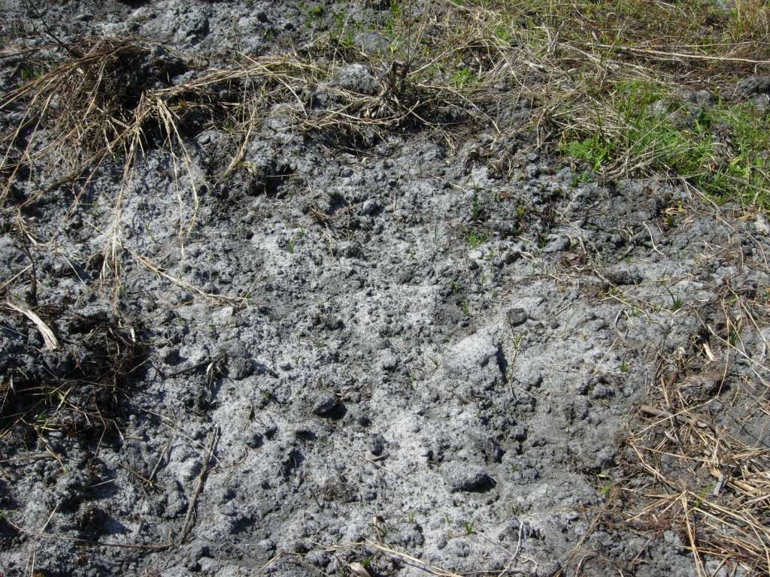
Age Category 2-< 1 month
Notes:
While plants in background are dead, very little is starting to resprout. This photo was taken during the dry season

Slide 17
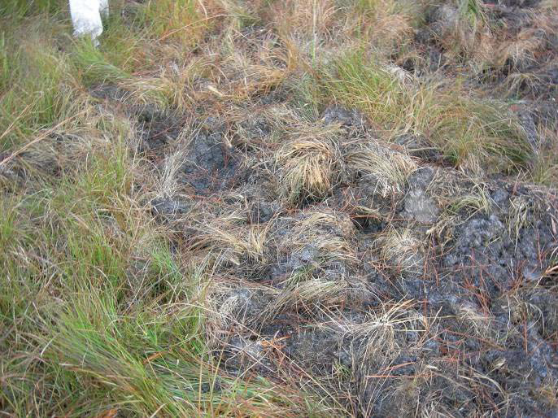
Age category 2-vegetation beginning to wilt, yellow and die

Slide 18
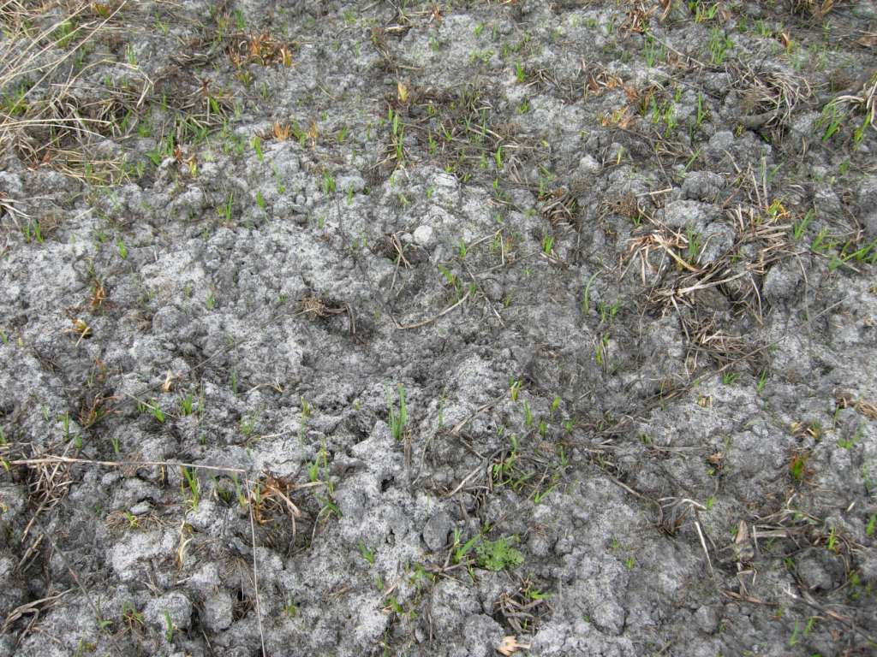
Age Category 3-2 to 3 months
Notes:
Soil is really beginning to “mellow”; several green plants have sprouted and could be identified to genus

Slide 19
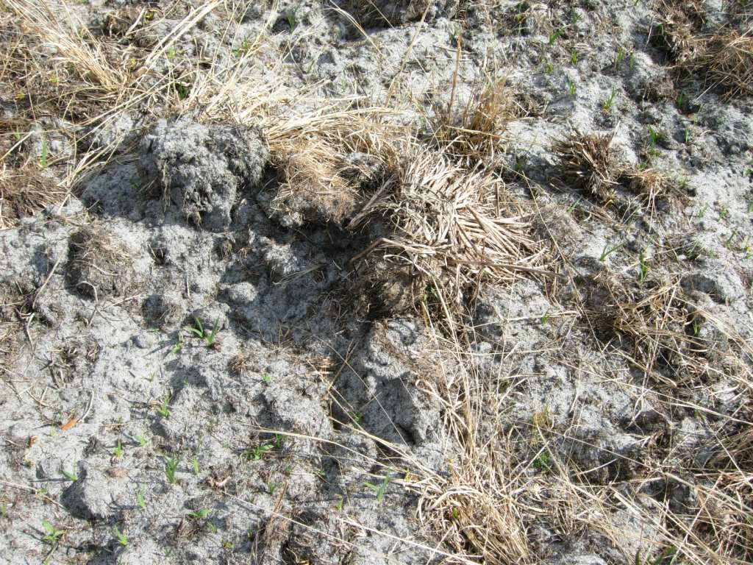
Age Category 3-2-3 months
Notes:
Disturbed vegetation dead, plants sprouting

Slide 20
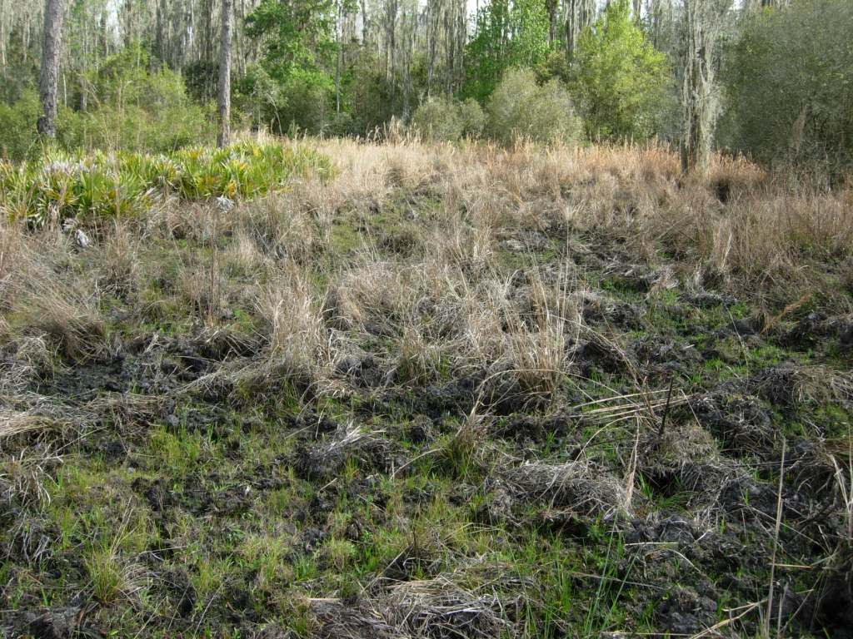
Age Category 4-4 to 6 months
Notes:
Again, this is a dry season photo but you’re getting good coverage of young plants, many distinguishable to species. You can also tell that this was a severely rooted wetland as some of the mounds are not weathered down yet although this is also a seasonal effect due to little or no rainfall

Slide 21
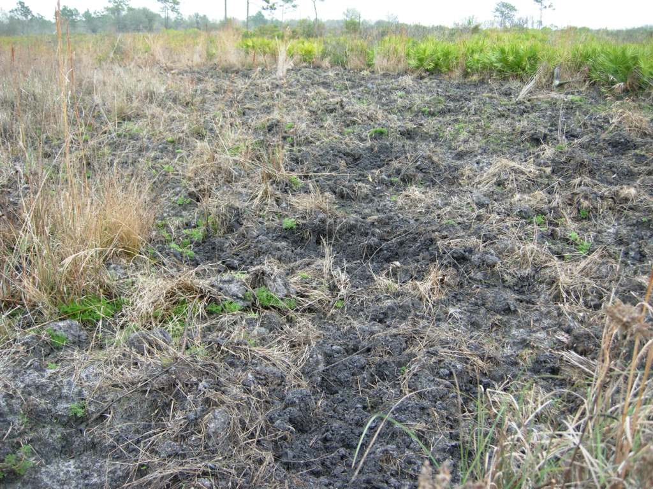
Acknowledgements
Mixed Ages of Disturbance
USDA-Wildlife Services Division
District staff:
Paul Elliott
Andy Hinkle
Joe Howell

Slide 22
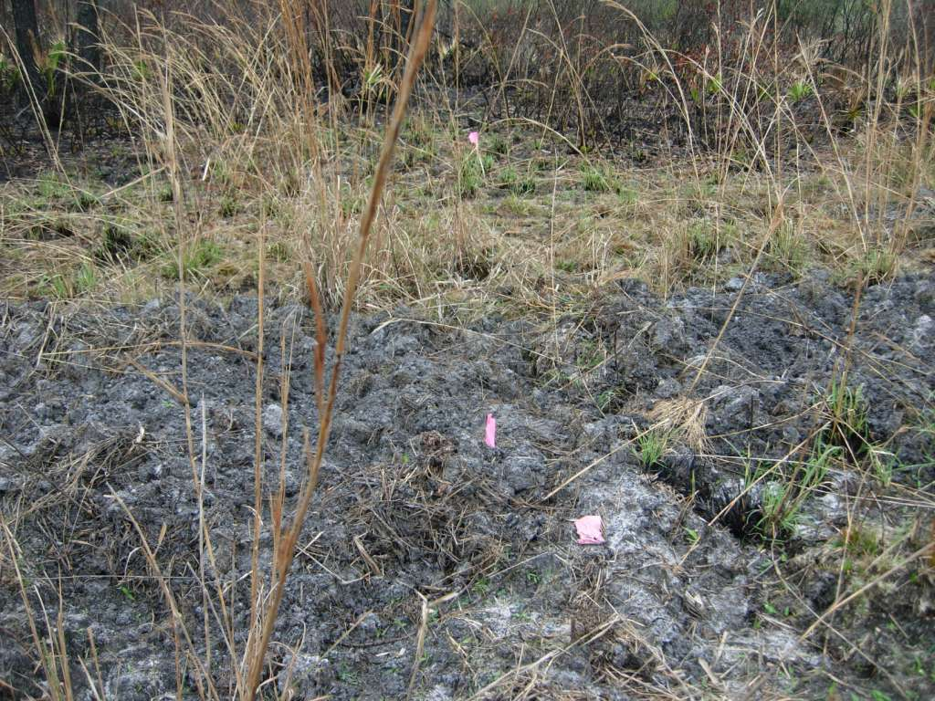

Slide 23
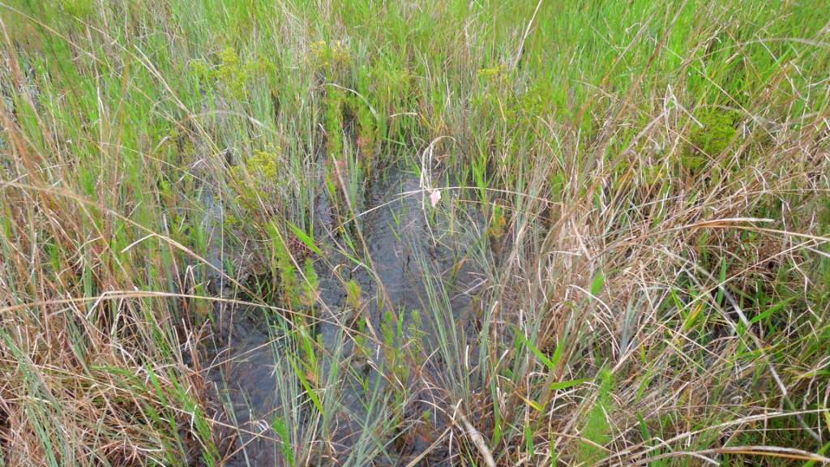
Why do we care?
Photo: Karen Gruenhagen

Slide 24
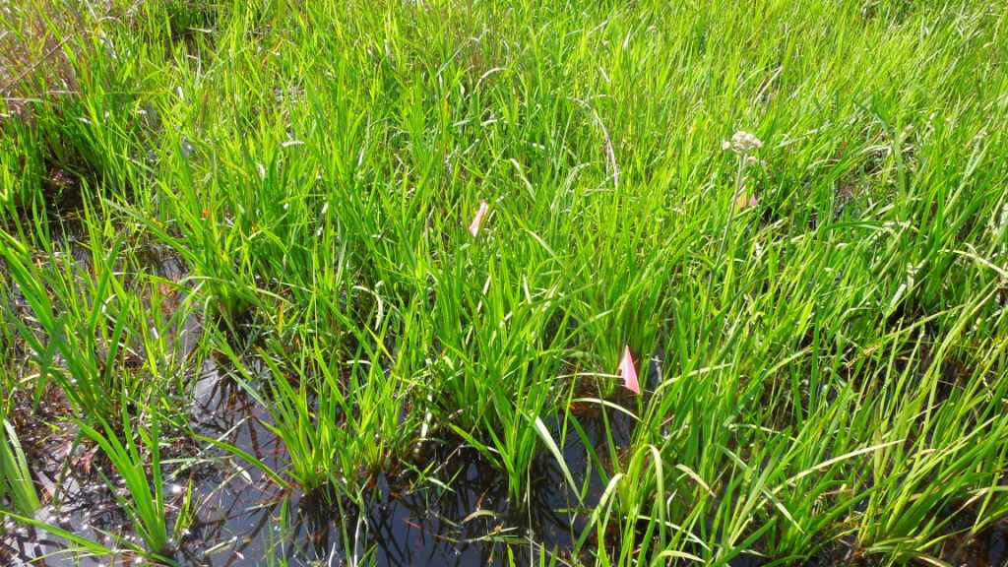
This area is dominated by redroot…
Photo: Karen Gruenhagen

Slide 25
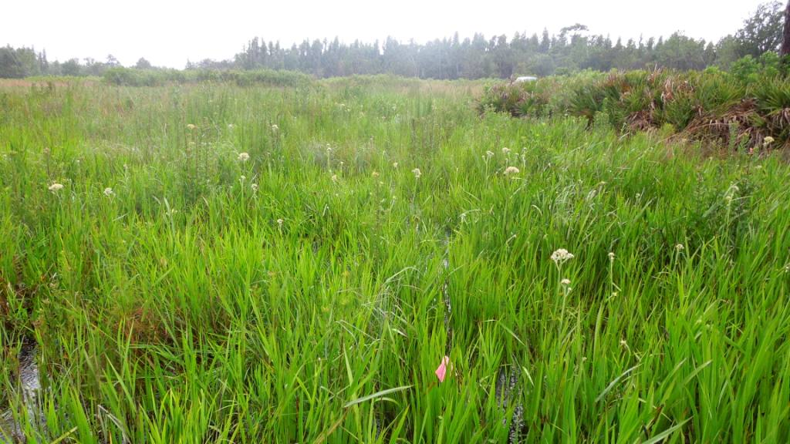
Photo: Karen Gruenhagen

Slide 26
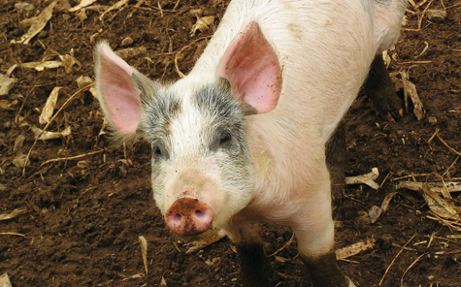
That’ll do pig…that’ll do
Questions?

