Slide 1
Most Impacted Area Recharge Salt Water Intrusion Minimum Aquifer Level Recovery at Flatford Swamp (H089)
J.P. Marchand, P.E.
Bureau Chief
December 14, 2021
Water Resources
Notes:
Good morning….
Action item and we’ll be requesting approval of a scope and cost change, and a related Budget transfer of $450K, to increase funds available to add a disinfection system to the …. Project.
Provide background on project, purpose of the transfer and staff recommendation.

Slide 2
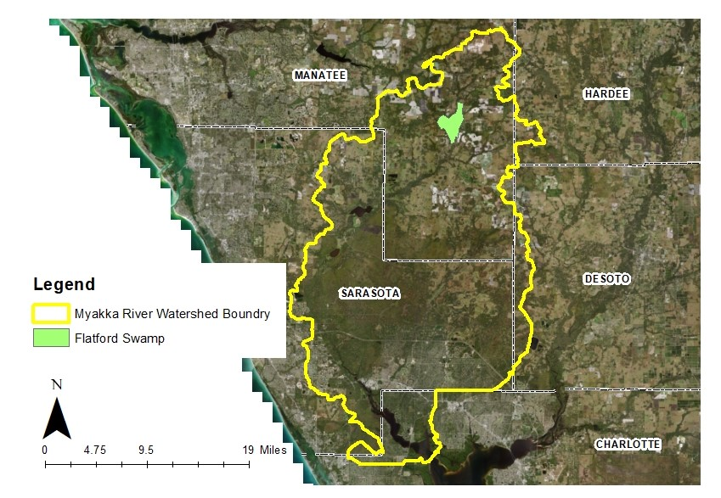
Notes:
Brief Background:
District owns some 235 Acres commonly known as Flatford Swamp, located upper Myakka River Watershed in eastern Manatee County. Flatford Swamp has been impacted by excess water flowing from upstream tributaries seriously affecting the swamp hydrology, particularly too much water during the dry season. Most obvious effect is tree die off. Some FARMs projects are helping but we have estimated that, on an average annual basis, there is approximately 10 mgd of excess water impacting the swamp.
land use alteration (agriculture combined with unique area) :
There is unique geology/geomorphology in this area. Where 5-8 feet below ground you have a hard-pan surface (clay)
The swamp basically sits in a kind of bowl
We’ve tried to address this issue through beneficial reuse projects like this one
The agricultural users in this area haven’t been over-permitted for water use, but the geology/geomorphology is complex enough that these are the only real, feasible kinds of solutions – beneficial reuse of these excess quantities of water
land use changes and alterations that disrupted the hydroperiods and caused significant tree die off. The Swamp has too much water.
investigated with an integrated model to determine estimates of the excess water.

Slide 3
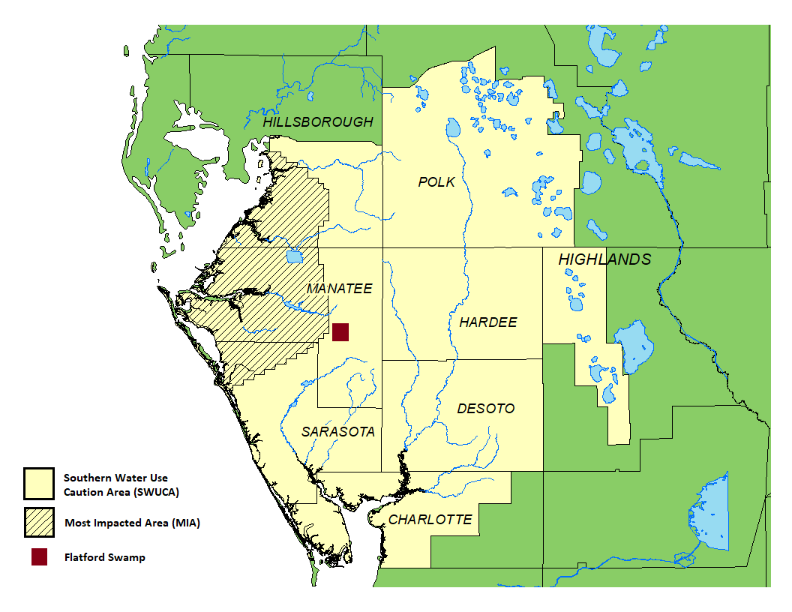
Multiple Benefits
Help restore hydroperiod
Improve aquifer level in the Southern Water Use Caution Area (SWUCA)
Potential water supply source
​
Notes:
The original intent of the Flatford Swamp project was to try and restore the hydroperiod in the area by removing excess water whenever available but particularly in the dry season. In trying to achieve that objective, we also looked for options that could provide some beneficial use of the excess water.
Flatford is in the SWUCA and just east of Most Impacted Area (MIA). (See map). The basic problem in the SWUCA is the significant reduction in ground water levels in the UFA that have occurred. Diverting the excess water from Flatford Swamp to recharge the UFA will increase ground water levels. This helps to meet the SaltWater Intrusion Minimum Aquifer Level (SWIMAL) established for the MIA, and hence also helps to mitigate Saltwater intrusion. Goal #3 of the SWUCA.
Additionally, the increased aquifer levels may provide opportunities for future AWS in the SWUCA to assist in meeting the increase in water supply demands. Goal #4 of the SWUCA. In their 2020 Integrated RWSP, the PRMRWSA has identified a Potential Water Supply Development Project using aquifer recharge at Flatford. Also in the District’s 2020 RWSP.
Current project objective is to achieve multiple benefits of hydroperiod restoration while helping to meet Goals 3 And 4 of the SWUCA.
Removal of this excess water from the wetlands will assist with achieving more natural hydroperiods.

Slide 4
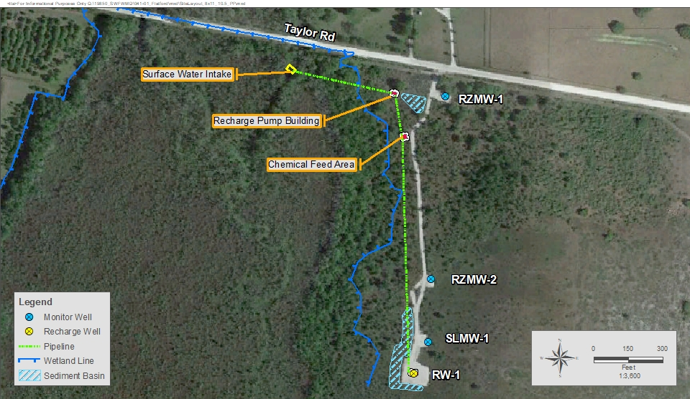
Project Status
Test Well Permitting - February 2017
Board approval of Test Well - April 2017
Well Construction - Completed April 2019
​
Surface Infrastructure - Completion June 2022. ​
​
Notes:
Ultimately the project could consistent of five recharge wells to recharge the estimated available excess water of approx. 10 mgd. Initially, one test well has been proposed to confirm the feasibility and permittability of the larger project. There are several components to this initial test well: surface diversion facility, piping, pumping facility, chemical feed system, the recharge well itself and three monitoring wells. This test well was permitted for construction and testing, and in April 2017, the Board approved moving ahead with construction. Test well and monitoring well construction was completed in April 2019 and surface facilities are essentially complete except for the additional treatment systems that are the subject of this budget transfer request. If approved, construction is to be completed by June 2022.
Well construction- recharge approx. 1300 ft in UFA
RZMW1-2: UFA monitor well approx. 1100 ft
SLMW-in zone above UFA
Baseline wetland monitoring in test well area for USACE permit.

Slide 5
Revised Permitting Direction
May 2021: New direction
Meet Primary Drinking Water Standards prior to injection
Requires chemical disinfection
April 2017: Governing Board approval
Based on non-disinfected surface water for recharge
Notes:
Additional treatment of the Flafford Swamp water is required prior to recharge because of new direction regarding project permitting. In May of this year, we rec’d direction that the recharge water must meet primary drinking water standards prior to injection. In order to meeting primary standards, chemical disinfection must be added. We did not anticipate this requirement as in our April 2017 project description, which the Board approved, the project was specifically proposed to use non-disinfected surface water for recharge.
Our understanding is new interpretation by FDEP based on direction of EPA.
Resulted in reevaluation of the requirements of a test permit. Coliform is only constituent of concern in primaries

Slide 6
Additional Chemical Disinfection
$300,000 in equipment installation
Includes concrete pads, instrumentation and controls, tank install, electrical
$120,000 in chemicals
$ 30,000 in chemical equipment lease for FY22
Includes tanks and pumps
Includes maintenance, repair and on call support
Notes:
The needed additional disinfection system includes:
- $300K for installation of necessary equipment (pads, tanks, instrumentation) through our on-site Contractor
Plus $120K for chemicals to get through the FY22 testing
And $30K to lease some of the installed equipment through FY22 after our on-site contractor is finished and released.
For total of $450,000
The leasing of the chemical equipment (tanks, pumps, etc) is unusual but advantageous as it includes maintenance and repair services and on call support. District staff do not have expertise in maintaining this equipment.
Chemicals for remaining months 7.5 months

Slide 7
Budget Transfer
$450,000 from Underground Injection Control Study (P228)
Funds not needed
$450,000 to Flatford Swamp (H089)
For chemical disinfection
Notes:
The requested BT is to provide the needed $450K for the disinfection system and testing through FY22. The funds are available in the FY22 budget for a related project, the UIC Study project. This UIC Study project was to study the fate of microorganisms in the aquifer after injection of non-disinfected source water, as was originally anticipated for the Flatford project. Now that we have direction to disinfect the water prior to recharge, funding that UIC Study is not necessary now.
Contractor fees reported from the change order

Slide 8
Staff Recommendations
Approve change of scope for the MIA Recharge SWIMAL Recovery at Flatford Swamp (H089) project to include a disinfection system
Authorize staff to execute a budget transfer in the amount of $450,000 from the UIC Study (P228) project to the MIA Recharge SWIMAL Recovery at Flatford Swamp (H089) project to complete the construction and testing of the additional chemical disinfection
Notes:
Approve change of scope for the Most Impacted Area Recharge Salt Water Intrusion Minimum Aquifer Level Recovery at Flatford Swamp (H089) project to include a disinfection system.
Authorize staff to execute a budget transfer in the amount of $450,000 from the UIC Study Project (P228) to the Most Impacted Area Recharge Salt Water Intrusion Minimum Aquifer Level Recovery at Flatford Swamp (H089) project to complete the construction and testing of the additional chemical disinfection as required by FDEP to meet primary drinking water standards.

Slide 9
Questions

Slide 10
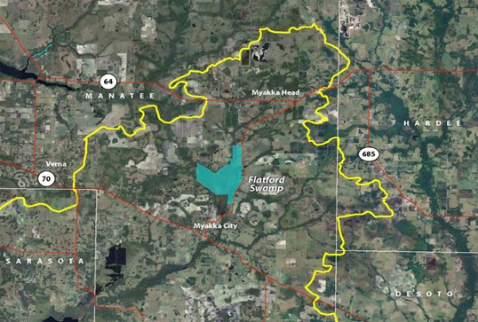
Notes:
Approximately 235 acres. Pink square is test well project area.

Slide 11
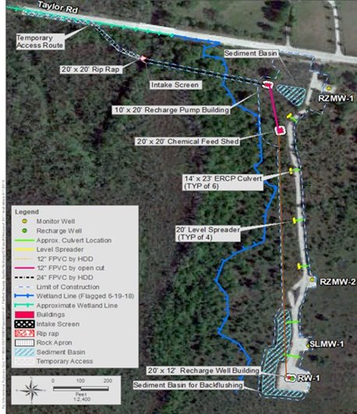
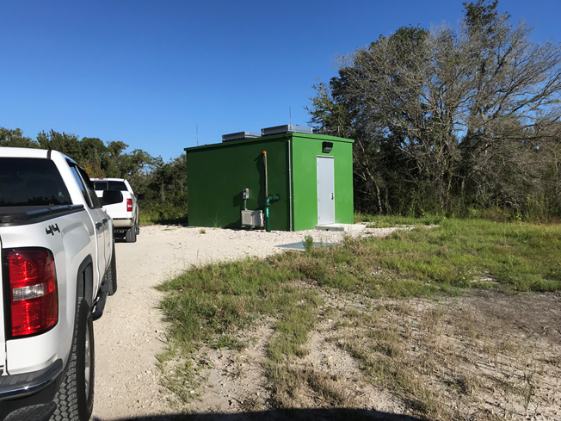
Notes:
Intake structure in Myakka River. To pump house. To chemical feed shed Sodium Bisufite added to mitigate arsenic mobilization in the aquifer.

Slide 12
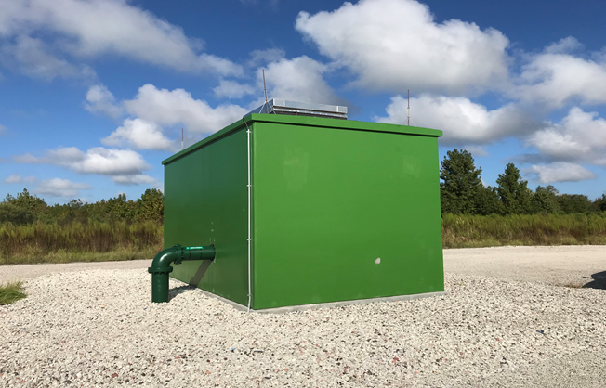
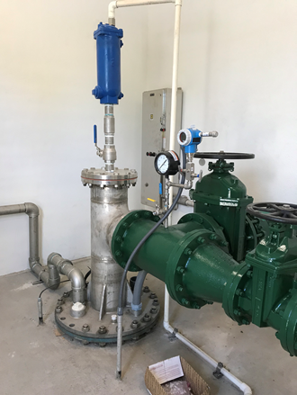
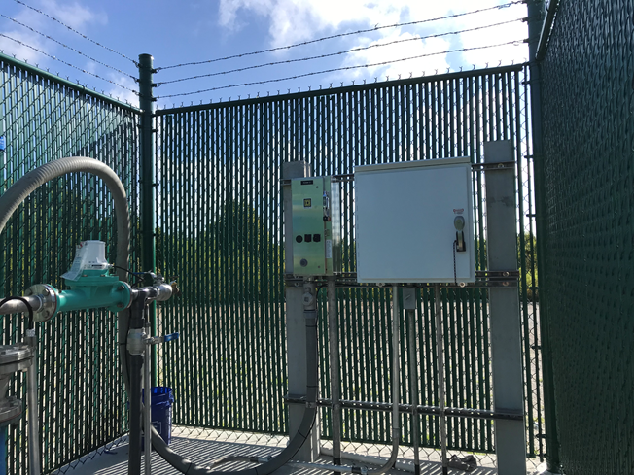
Notes:
Finally to recharge building to the well. All monitor wells are similar set up

